Slide 1
File Management

Slide 2
File management is a major function of an operating system
User need know how data is stored or retrieved from secondary storage

Slide 3
Computer Storage
There are two levels of storage in a computer
Main memory – Temporary stores data and programs being executed - volatile
Secondary storage - stores data and programs permanently, for future use. Non-volatile

Slide 4
File System
The file system is the most visible aspect of an operating system.
It provides the mechanism for on-line storage of and access to both data and programs of the operating system and all the users of the computer system.
The file system consists of two distinct parts: a collection of files, each storing related data, and a directory structure, which organizes and provides information about all the files in the system.

Slide 5
Minimum User Requirements
View
Read(open)
Write(save)
Edit
Copy/Cut
Move

Slide 6
Secondary storage devices
Magnetic tapes
Magnetic disks – Hard disc, zip disk
Optical Disc – CD, DVD

Slide 7
Computer Files
Data is stored in secondary storage in form of files.
A file has two components
Name – uniquely identifies the file in secondary storage
Extension – denotes file format

Slide 8
Physical Vs Logical files
For convenient use of the computer system, the operating system provides a uniform logical view of information storage. The operating system abstracts from the physical properties of its storage devices to define a logical storage unit, the file. Files are mapped, by the operating system, onto physical devices.

Slide 9
OS File Management Functions
The operating system is responsible for the following activities in connection with file management:
The creation and deletion of files
The creation and deletion of directory
The mapping of files onto disk storage.
Backup of files on stable (non volatile) storage

Slide 10
File Control Block
File control block
storage structure consisting of information about a file.
File attributes include:
Name: The symbolic file name is the only information kept in humanreadable form.
Identifier: This unique tag, usually a number, identifies the file within the file system; it is the non-human-readable name for the file.
Type: This information is needed for those systems that support different types.
Location: This information is a pointer to a device and to the location of the file on that device.

Slide 11
Size: The current size of the file (in bytes, words, or blocks), and possibly the maximum allowed size are included in this attribute.
Protection: Access-control information determines who can do reading, writing, executing, and so on.
Time, date, and user identification: This information may be kept for creation, last modification, and last use. These data can be useful for protection, security, and usage monitoring.

Slide 12
File operations
Creating a file: create a file space in the file system must be found for the file. An entry for the new file must be made in the directory. The directory entry records the name of the file and the location in the file system, and possibly other information.
Writing a file: To write a file, we make a system call specifying both the name of the file and the information to be written to the file.

Slide 13
Reading a file: To read from a file, we use a system call that specifies the name of the file and where (in memory) the next block of the file should be put.

Slide 14
Deleting a file: To delete a file, we search the directory for the named file. Having found the associated directory entry, we release all file space, so that it can be reused by other files, and erase the directory entry.
Truncating a file: The user may want to erase the contents of a file but keep its attributes. Rather than forcing the user to delete the file and then recreate it, this function allows all attributes to remain unchanged-except for file length-but lets the file be reset to length zero and its file space released.

Slide 15
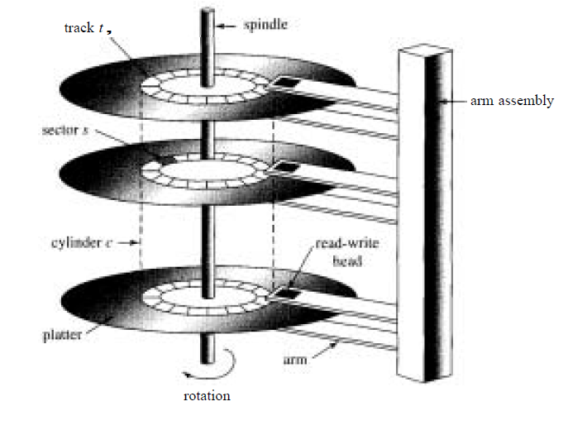
Structure of a disk

Slide 16
Formatting – Prepares the disk for data storage. Disk surface is divided into concentric circles known as tracks which are further divided into sectors
Each sector has an address which uniquely identifies its location

Slide 17
Disk Access Times
When computer is in use, files are transferred between main memory and secondary storage.
The operating system is responsible for using hardware efficiently — for the disk drives, this means having a fast access time and disk bandwidth.
Access time has two major components
Seek time is the time for the disk are to move the heads to the cylinder containing the desired sector.
Rotational latency is the additional time waiting for the disk to rotate the desired sector to the disk head.
Head switching time – activate head for reading or writing
Data transfer
Minimize seek time
Seek time ≈ seek distance
Disk bandwidth is the total number of bytes transferred, divided by the total time between the first request for service and the completion of the last transfer.

Slide 18
Disk Scheduling
Several algorithms exist to schedule the servicing of disk I/O requests. Examples
FCFS
SSTF
SCAN
CSCAN
LOOK
CLOOK
We illustrate them with a request queue (0-199) of cylinders requested
98, 183, 37, 122, 14, 124, 65, 67
Head pointer is at 53

Slide 19
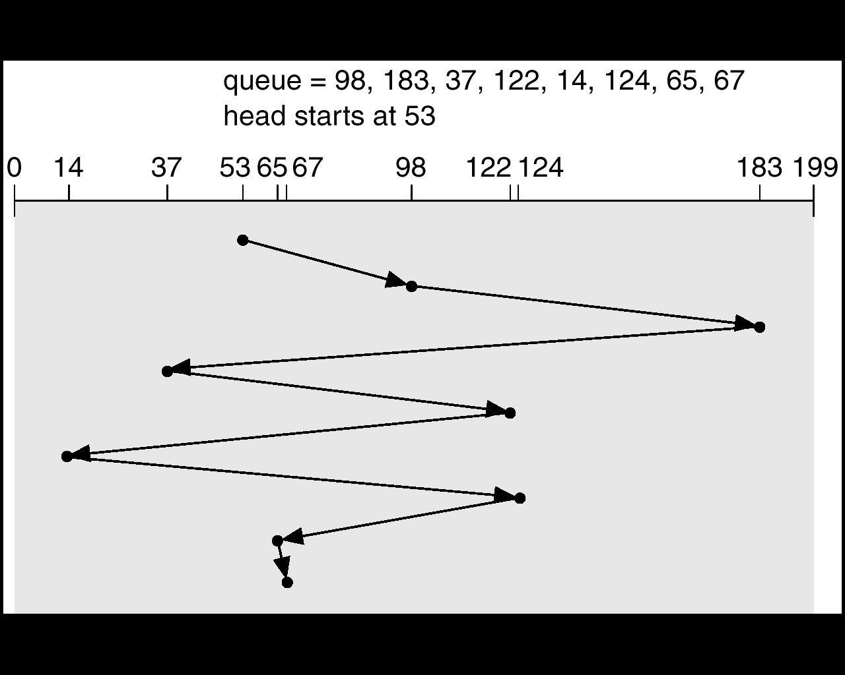
FCFS
Arrival order of service requests is used
Total head movement of 640 cylinders.

Slide 20
SSTF
Selects the request with the minimum seek time from the current head position.
.

Slide 21
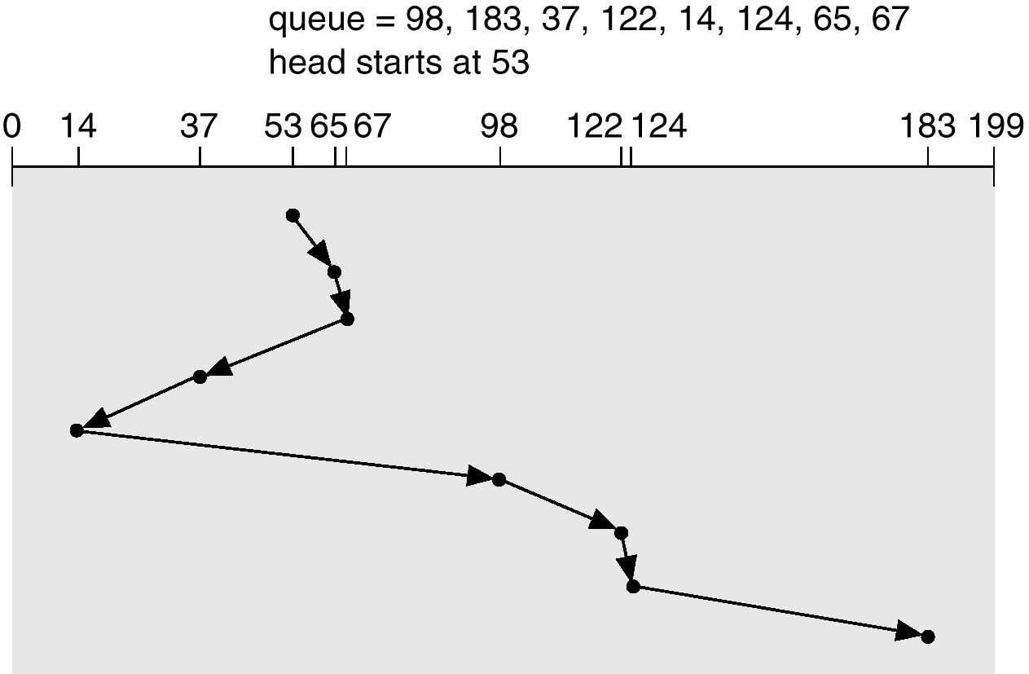
SSTF
Total head movement of 236 cylinders.

Slide 22
SCAN
The disk arm starts at one end of the disk, and moves toward the other end, servicing requests until it gets to the other end of the disk, where the head movement is reversed and servicing continues.
Sometimes called the elevator algorithm.
.

Slide 23
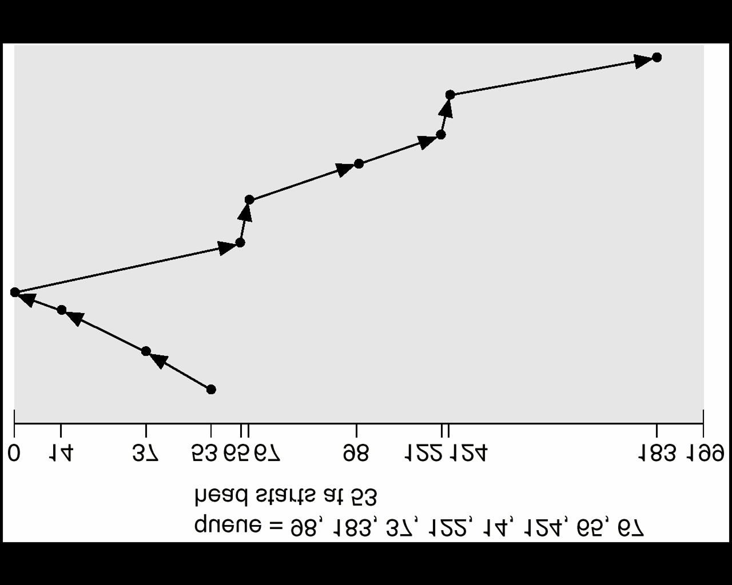
SCAN (Cont.)

Slide 24
C-SCAN
The head moves from one end of the disk to the other. servicing requests as it goes. When it reaches the other end, however, it immediately returns to the beginning of the disk, without servicing any requests on the return trip.

Slide 25
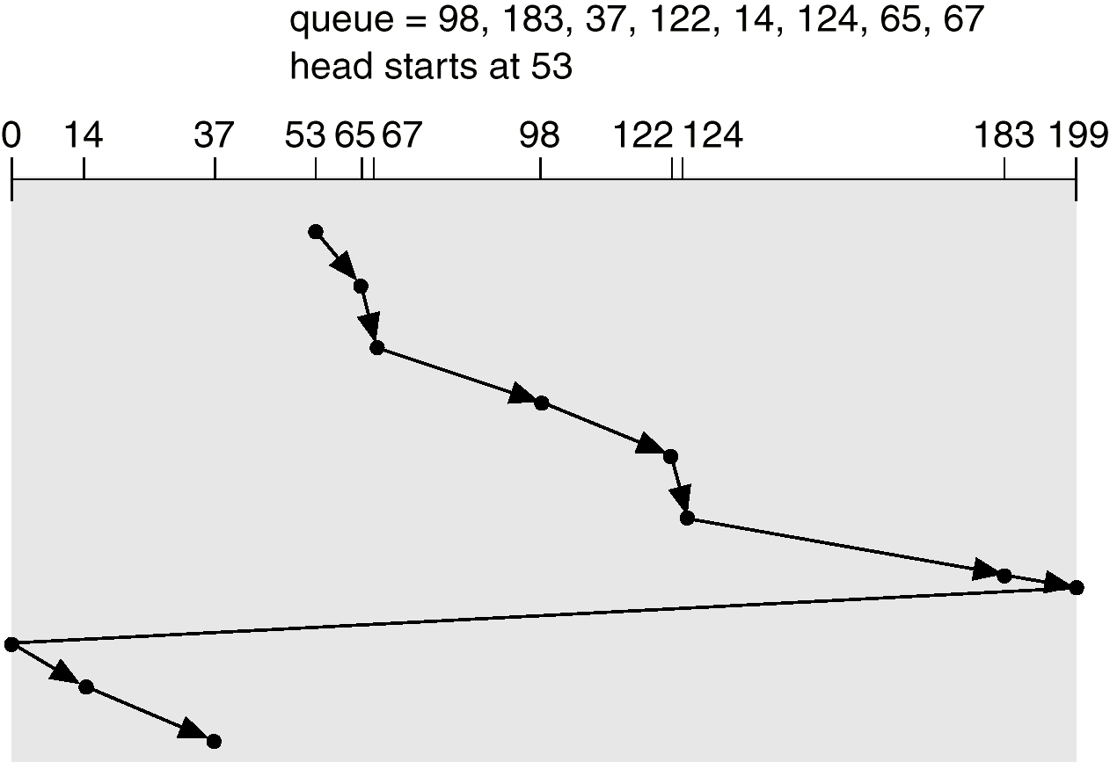
C-SCAN (Cont.)

Slide 26
LOOK and C-LOOK
Arm only goes as far as the last request in each direction instead of till the last cylinder
LOOK and C-LOOK are obtained from SCAN and C-SCAN by using this idea

Slide 27
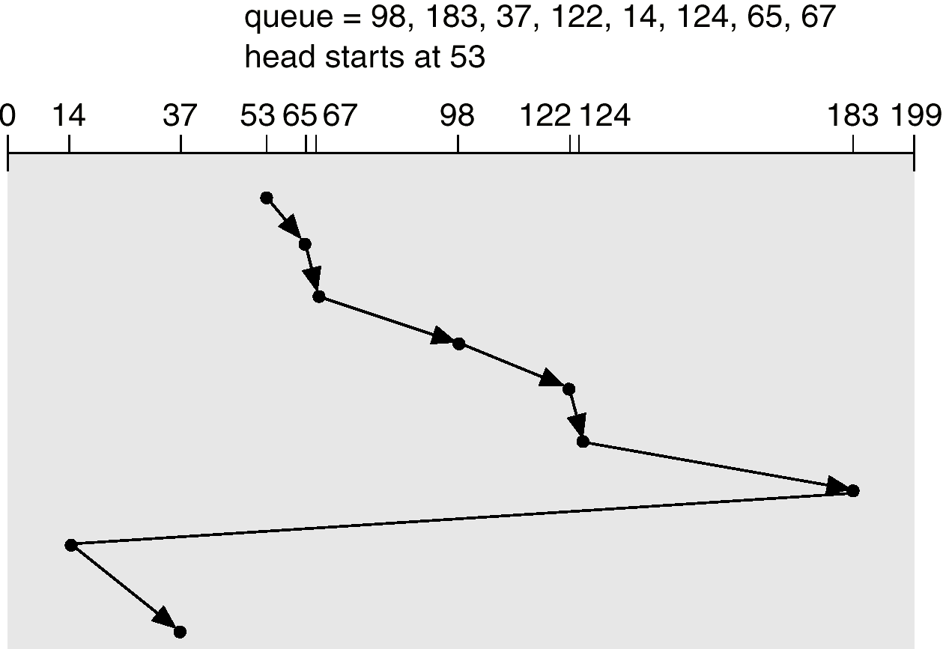
C-LOOK (Cont.)

Slide 28
Selecting a Disk-Scheduling Algorithm
SSTF is common and has a natural appeal
SCAN and C-SCAN perform better for systems that place a heavy load on the disk.
Performance depends on the number and types of requests.
Requests for disk service can be influenced by the file allocation method.
The disk-scheduling algorithm should be written as a separate module of the operating system, allowing it to be replaced with a different algorithm if necessary.
Either SSTF or LOOK is a reasonable choice for the default algorithm.

Slide 29
Directory Structure
file systems may consist of millions of files
Typically, OS defines
Containers that can store files
Called partitions, volumes, etc
May span one or more devices
A Directory provides a logical grouping of files

Slide 30
Information in a Device Directory
Name
Type
Address
Current length
Maximum length
Date last accessed
Date last updated
Owner ID
Protection information

Slide 31
Organize the Directory (Logically) to Obtain
Efficiency – locating a file quickly.
Naming – convenient to users.
Two users can have same name for different files.
The same file can have several different names.
Grouping – logical grouping of files by properties, (e.g., all Java programs, all games, …)

Slide 32
Evolution of Directory Structures

Slide 33
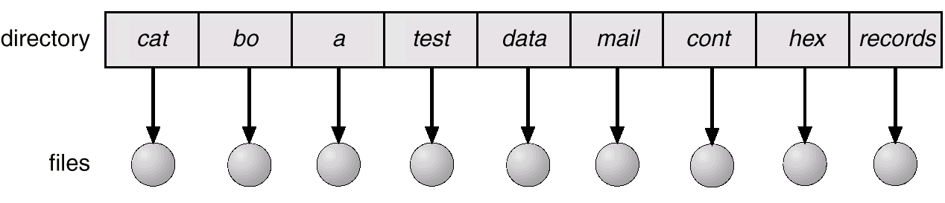
Single-Level Directory
A single directory for all users.
Naming problem
Grouping problem

Slide 34
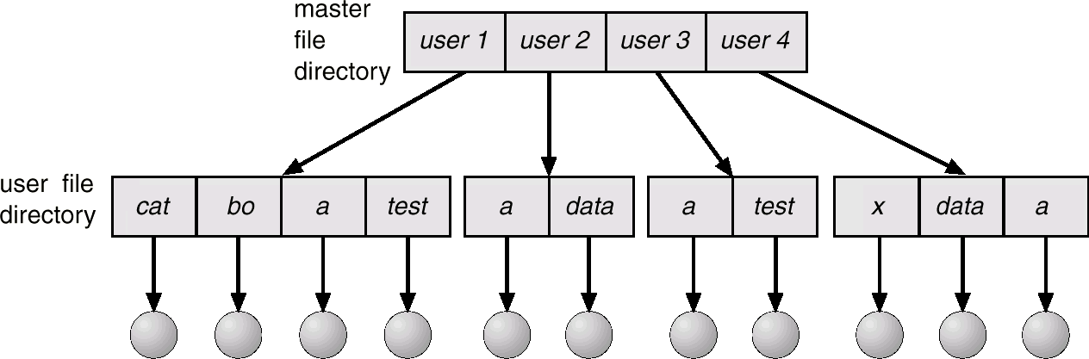
Two-Level Directory
Separate directory for each user.
Path name
Can have the same file name for different user
Efficient searching
No grouping capability

Slide 35
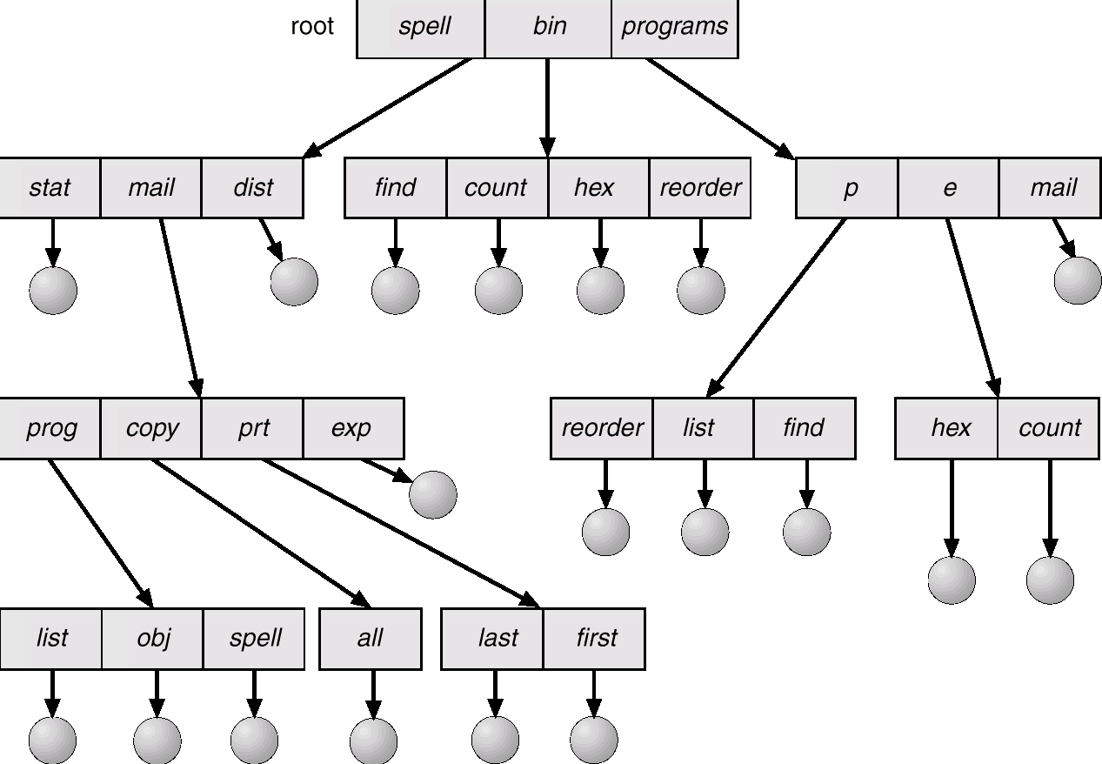
Tree-Structured Directories

Slide 36
Allocation Methods
An allocation method refers to how disk blocks are allocated for files:
Contiguous allocation
Linked allocation
Indexed allocation

Slide 37
Contiguous Allocation
Each file occupies a set of contiguous blocks on the disk.
Simple – only starting location (block #) and length (number of blocks) are required.
Wasteful of space (dynamic storage-allocation problem).
Files cannot grow.

Slide 38
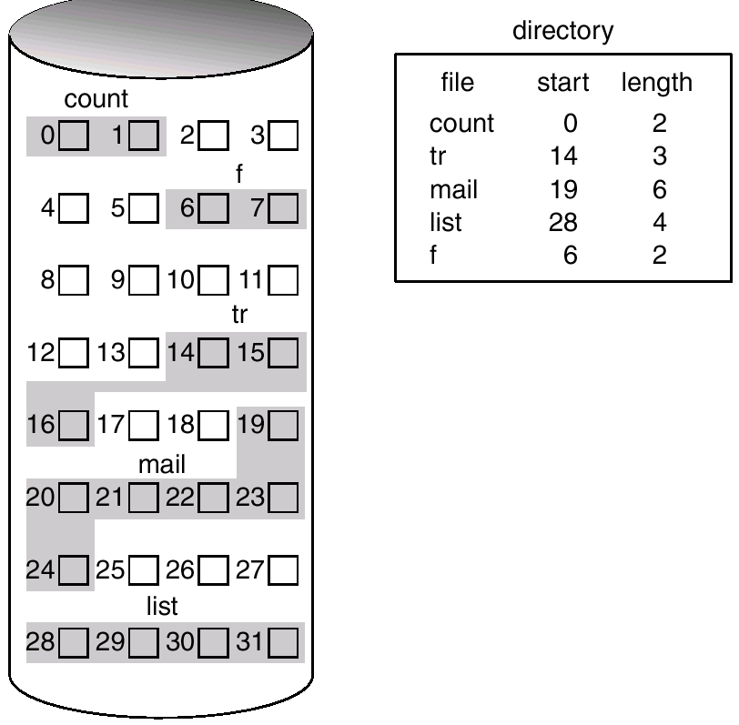
Contiguous Allocation of Disk Space

Slide 39
Linked Allocation
Each file is a linked list of disk blocks: blocks may be scattered anywhere on the disk.
block =
pointer
Data

Slide 40
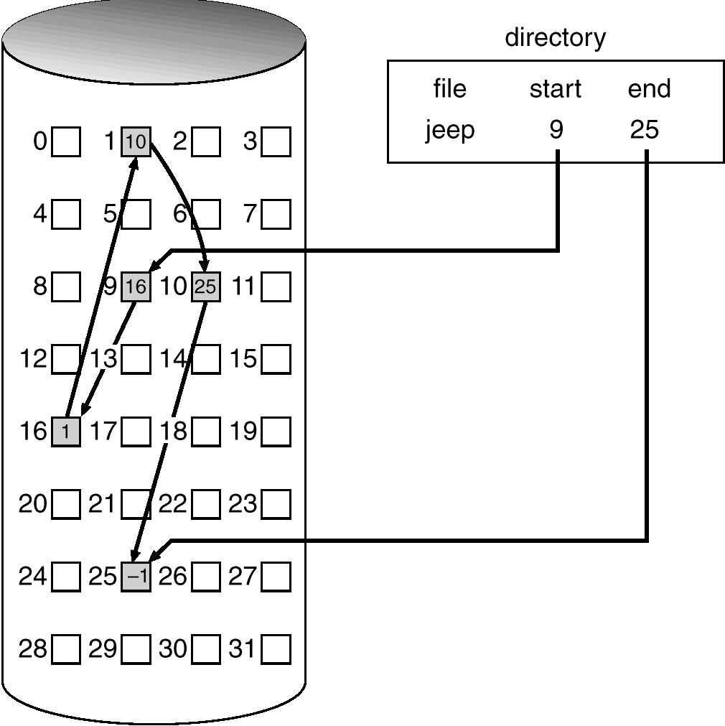
Linked Allocation

Slide 41
Indexed Allocation
Brings all pointers together into the index block.
Logical view.
index table

Slide 42
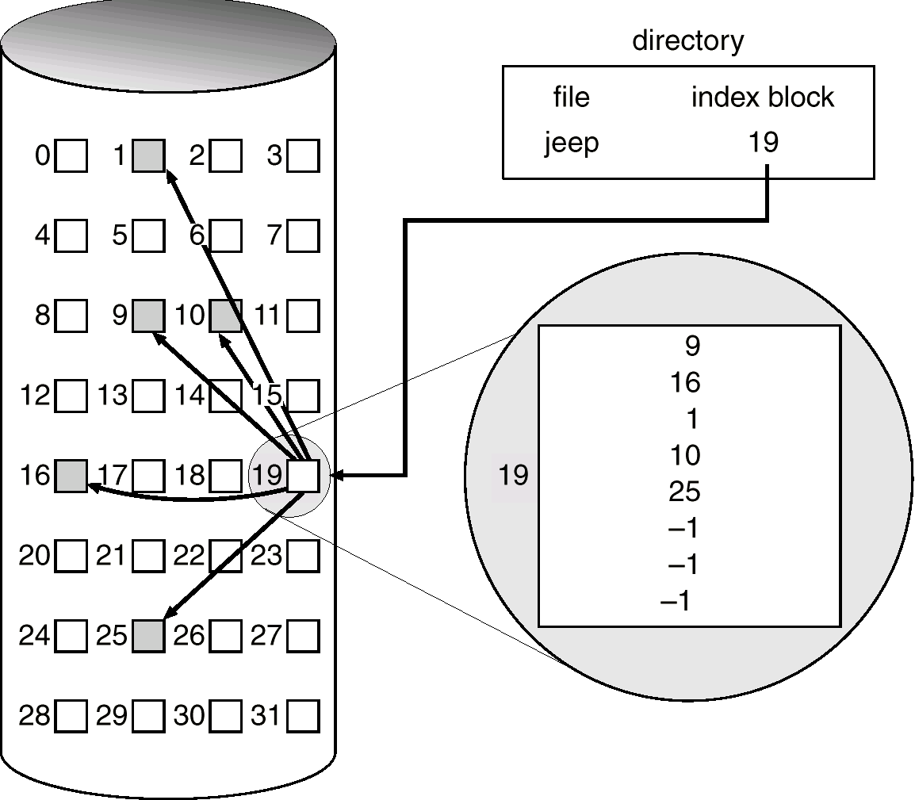
Example of Indexed Allocation

Slide 43
END

